Slide 1
FY20 Iowa MIECHV Benchmark Annual Training
August 24, 2020

Slide 2
FY20 Iowa MIECHV Benchmark Measures Update
The purpose of this training is to review:
HRSA Benchmark Measure changes
Performance improvement requirements
Scheduling Report MIA Report
Form 2 Benchmarks Report enhancement

Slide 3
Your Data Matters
National Impact
Local Impact

Slide 4
Browser REMINDER!
Mozilla Firefox is supported!
Google Chrome is supported!
Internet Explorer is NOT supported!
Notes:
DAISEY is optimized in Firefox & Chrome are supported browsers. Please contact consult with program administrators if neither of these browsers are available to you.

Slide 5
HRSA Benchmark Measure Changes

Slide 6
HRSA Benchmark Measure Changes
At-a-glance document review
Form 2

Slide 7
HRSA Benchmark Measure Changes
Measure 6 – Tobacco Cessation Referral
HRSA required Iowa to specify when a primary caregiver uses tobacco in the home. Updated data collection in January 2020.
Form: Primary Caregiver EAR
Timing Selection: Enrollment
Current question: Does anyone in the household use tobacco products in the home? If “Yes”, then…
New question(Jan2020): Is the primary caregiver using tobacco in the home?
Updated logic: If “Yes”, included the denominator, if “No”, not included.

Slide 8
HRSA Benchmark Measure Changes
Measure 12 – Developmental Screening
HRSA required Iowa to choose either 24 OR 30 month screener to be included.
Form: ASQ-3
Updated timing Selection to be reported: 30 month (additional Iowa requirements)
NO CHANGE IN WORKFLOW

Slide 9
HRSA Benchmark Measure Changes
Measure 17 – Depression Referrals
HRSA is requiring that states include any primary caregiver that has EVER been included in this denominator until they meet the numerator.
Form: EPDS
Update: Any primary caregiver meeting the denominator will remain in count until they are included in the numerator. This is more of a cumulative count now.
NO CHANGE IN WORKFLOW

Slide 10
HRSA Benchmark Measure Changes
Missing Data Requirements
HRSA enforcing how to handle missing data.
Implemented at end of FY19 to HRSA
If not enough information to determine inclusion, is considered missing
Measures with missing data > 10% requires justification
Published DAISEY Form 2 DAISEY Report enhancement

Slide 11
Performance Improvement Requirements

Slide 12
Performance Improvement Requirements
MIECHV Demonstration of Improvement in Benchmark Areas: Improvement in a benchmark area is defined as meeting the identified measure-level improvement criteria in at least one-third (33.3%) of the measures under a specified benchmark area (rounded to the closest whole number), with a minimum of improvement in at least one measure for each benchmark area. More information can be found here. Improvement for a measure is defined as meeting one or both of the following criteria: 1) Any change in the intended direction for that measure, as compared to baseline.
2) Meeting or exceeding the established threshold for a measure, while simultaneously not decreasing performance from baseline by more than 10%.

Slide 13
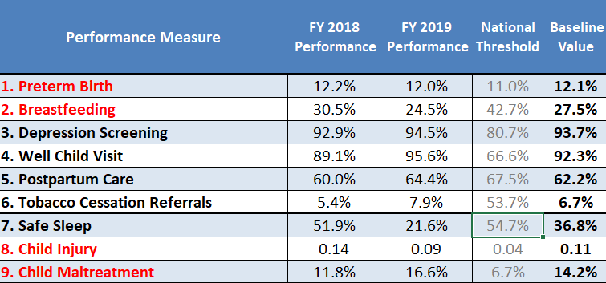
Performance Improvement Requirements

Slide 14
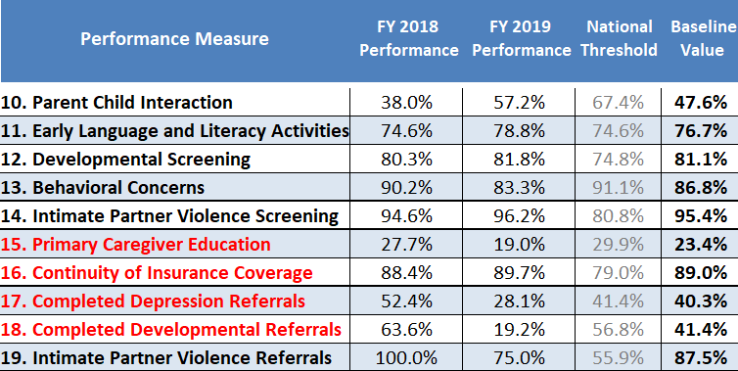
Performance Improvement Requirements

Slide 15
Schedulding Report MIA Enhancement

Slide 16
Scheduling Report Enhancement
Scheduling Report Enhanced to minimize report maintenance
Missing Demographics Report

Slide 17
Form 2 Benchmark Report Enhancement

Slide 18
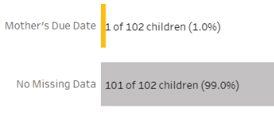
Form 2 Benchmark Report Enhancement
Missing Data Enhancement

Slide 19
Form 2 Benchmark Report Enhancement
Next data due date: OCTOBER 15th
Fiscal Year 2020 (October 1, 2019 – September 30, 2020)

Slide 20
IOWA DAISEY Report Training
Report Training Video & Resources
daiseyiowa.daiseysolutions.org

Slide 21
IOWA DAISEY Report Training
Questions about DAISEY or Report functions?
daisey.iowa@ku.edu
Questions about data in the reports or how to use reports?
Program administrator (chain of command)

