Slide 1
IOWA MIECHV Discharge Reasons & Home Visits

Slide 2
MIECHV Primary Caregiver Discharge Reasons
Notes:
The Discharge Reason field is located at the bottom of the Caregiver Profile. There are eight options to choose from. The very last option on the list is “Other.” This option should only be chosen if there is no other reasonable option on the list that fits the discharge reason.

Slide 3
FY2021 Discharge Reasons
In fiscal year 2021, there was an influx of the use of the “Other” discharge reason.
Average is 2, FY21Q4 brought 71
After reviewing the explanations for using “Other,” it was determined that some of the instances of using “Other” could have chosen an option from the dropdown list instead.
10 of the 71 provided no explanation
Reducing misuse of “Other” strengthens data accuracy.

Slide 4
MIECHV Primary Caregiver Discharge Reasons
Why it matters?
Program quality improvement
Data quality
HRSA requirement (Completed, Stopped before completion, Other)
Notes:
The Discharge Reason field is located at the bottom of the Caregiver Profile. There are eight options to choose from. The very last option on the list is “Other.” This option should only be chosen if there is no other reasonable option on the list that fits the discharge reason.

Slide 5
Using the “Other” Option
If “Other” is the most appropriate discharge reason, selecting it will cause an explanation field to appear. This field MUST be completed when choosing “Other” as the discharge reason.
Notes:
If there are no options that fit the discharge reason, it’s okay to use “Other;” however, there must be an explanation put in the explanation field that appears when “Other” is selected.

Slide 6
“Other” Discharge Reason Misuse - Examples
Explanations in DAISEY: Suggested Reason:
Adoption of the child Parental rights terminated or lost custody
Child moved to Head Start Completed program or child aged out
Didn’t want virtual visits No longer interested in services
Missed visits/No call, no show No contact or could not locate
Utilizing another program No longer interested in services
Worker change was too frequent No longer interested in services

Slide 7
Questions
If you have questions or concerns regarding a discharge reason, please consult with your contract manager.
FY21Q4 data has been shared with IDPH. KU CPPR will pull this data again in FY22Q2 if "Other" categories remain high for targeted outreach.

Slide 8
How to find “Other” reasons
Log into DAISEY
Visit MIECHV Demographics and Service Report
Select “Service Utilization” Dashboard
Choose Underlying Data icon in Stopped services before completion bar
Select “Full Data” tab in pop-up
Select the “Show all columns” box
Click “download all rows as a text file” – Column JG will have responses to Question#3340, “Other(explain)” question in DAISEY

Slide 9
Home Visit Review Form

Slide 10
Home Visits, Two Ways!
The Home Visit Review Form was launched for CQI purposes with the intention of removing some duplicative efforts.
Number of Home Visits:
IDPH expects at least two Home Visit Review Forms for every caregiver enrolled at least one day in the month
Total # of HVs, two ways:
Home Visit Tracker Report (NEW) uses the HV Review Form
MIECHV Demographics and Service Report (current – used for HRSA annual reporting) uses the Quarterly Report- Primary Caregiver

Slide 11
FY2021 Q4 Data Comparisons
FY21Q4 Form 1(Quarterly Report- Primary Caregiver): 718 families, 3230 HVs reported
FY21Q4 Home Visit Tracker Report: 718 families, 3010 forms
In order to start using the Home Visit Review Form to report the total annual number of home visits, these numbers must reflect one another.

Slide 12
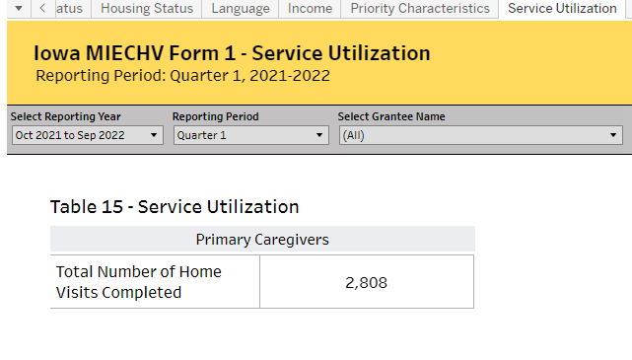
How to check your data
Compare the Demographics & Service Report (Form 1) Total Number of Home Visits on the Service Utilization Tab to the number of completed home visit forms on the Home Visit Tracker. These numbers should ideally be the same.
*Be sure filters are aligned on the reports during comparison.

Slide 13
IOWA DAISEY Report Training
Questions about the Home Visit Tracker Report or Home Visit Review Form?
Report Training Video & Resources
daiseyiowa.daiseysolutions.org

Slide 14
IOWA DAISEY Report Training
Questions about DAISEY or Report functions?
daisey.iowa@ku.edu
Questions about data in the reports or how to use reports?
Program administrator (chain of command)

